Slide 1

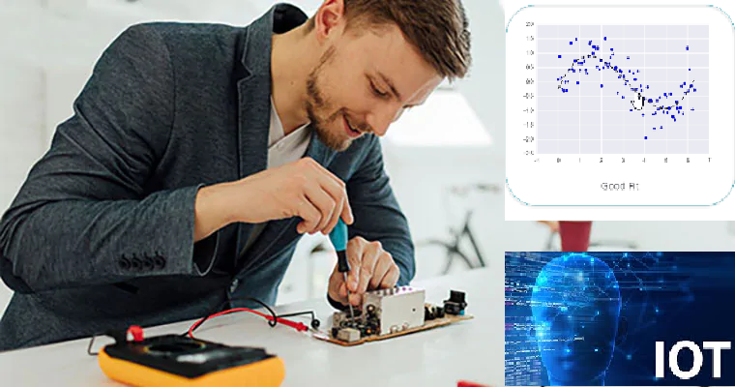
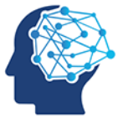

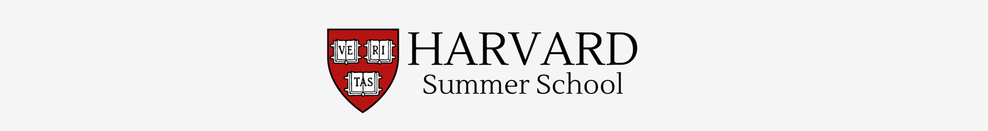
Wearable Devices and Computer Vision
Monday, June 22, 2020
Head Instructor: Jose Luis Ramirez Herran
TA’s: Souleymane Konate and Ricardo Villamil

Slide 2
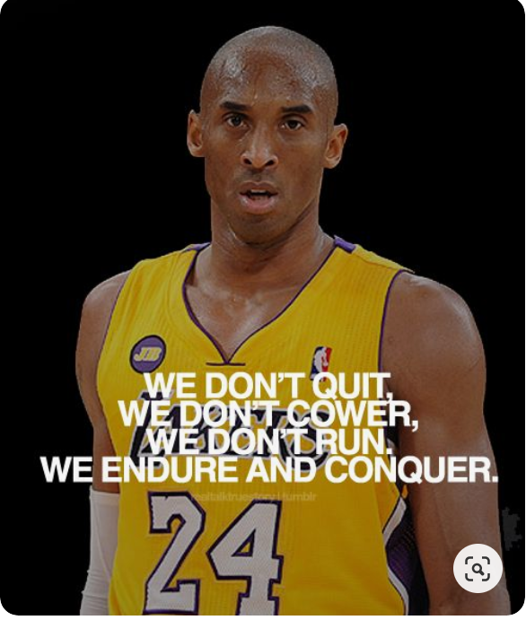
Today’s Lecture
Break
7:30 pm – 7:40 pm
Break
8:35 pm – 8:40 pm
Part 1
Introduction
Part 2
Hands-on Activity
Part 3
Homework
Questions?
Discussion
Projects
Logistics
6:30 pm – 7:30 pm
7:40 pm – 8:40 pm
8:50 pm – 9:30 pm

Slide 3
Break
7:30 pm – 7:40 pm
6:30 pm – 7:30 pm
Part 1
Introduction
Logistics

Slide 4
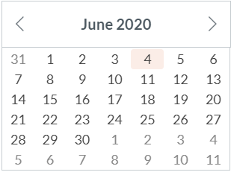
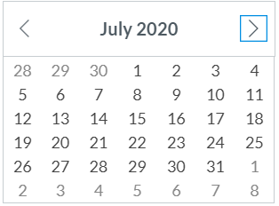
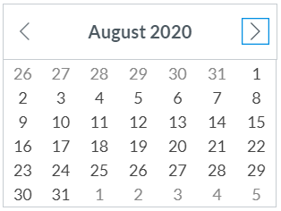
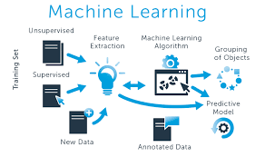
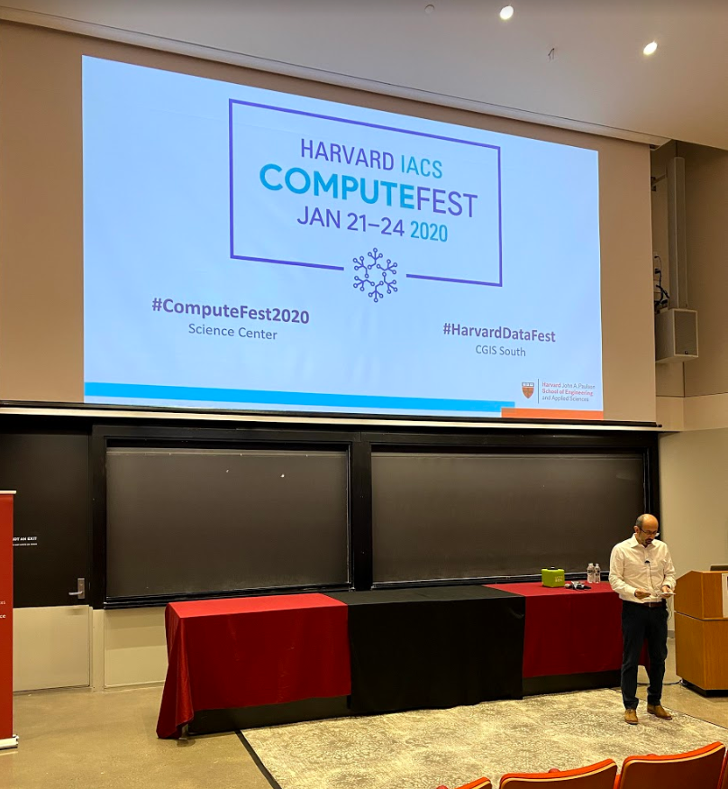
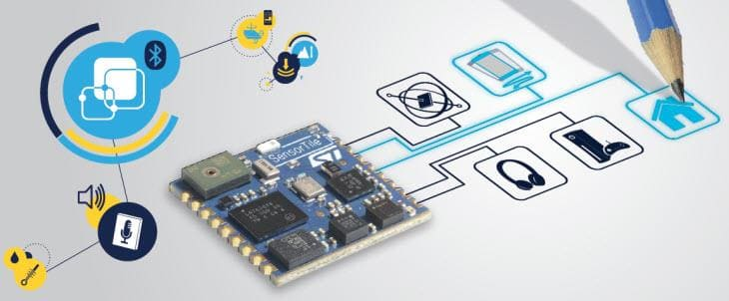
Calendar summer 2020
Mondays and Wednesdays 6:30 pm – 9:30 pm
Wearable Devices and Computer Vision
Project
presentations
Su M Tu W Th F S
SW+HW Setup.+ Basic Tutorials

Slide 5
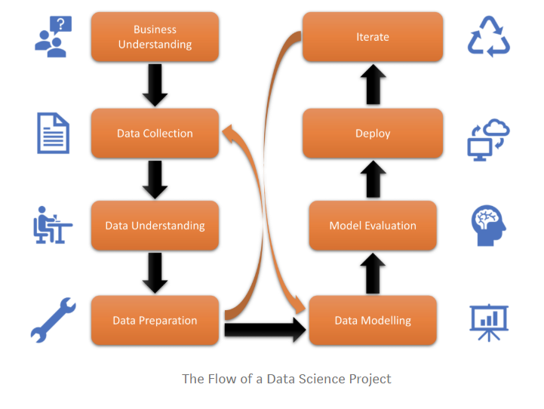
Course Description – Applied Knowledge
This practical course is for students who want to evolve from consumers of data to producers of data, and mine their data to innovate or create new experiences in our big data economy. Students assemble wearable devices using industry-standard sensors, collect a continuous flow of data about their bodies and environments, and learn how to analyze these data streams and use machine learning and artificial intelligence to do predictions.
Students are encouraged to use wearable devices as building blocks to help disabled persons, develop educational games, monitor senior citizens or personal health, or create artistic experiences they can share.
https://towardsdatascience.com/life-cycle-of-a-data-science-project-3962b9670e5b

Slide 6
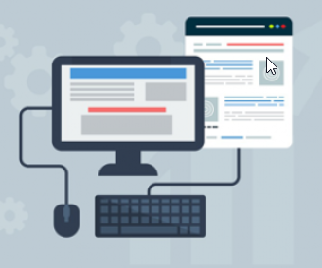
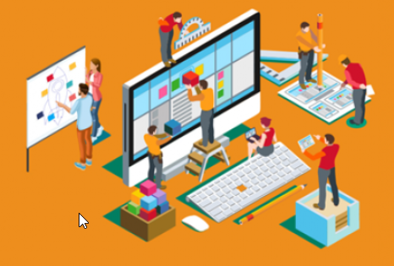
Course Description – Goals and Time
Prerequisites: Willingness to build things step-by-step and persistence when the things you have just created do not yet work as you expected and you need to troubleshoot them. High school linear algebra (matrices) and some experience with a programming language, such as Python.

Slide 7
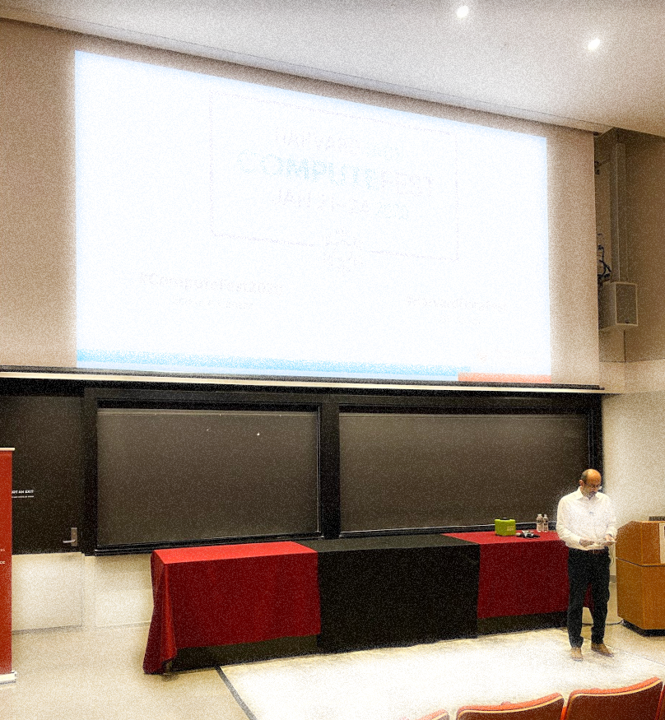
Course Description - Presentations
At the end of the semester, each student will present their final project to classmates and faculty.
Presentations will be held online live via Zoom (web conferencing software) or previously recorded presentations.

Slide 8
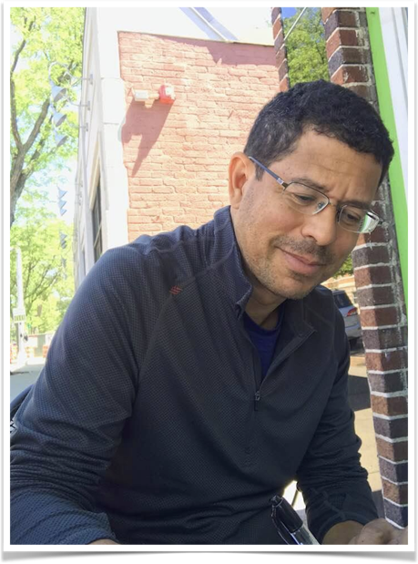
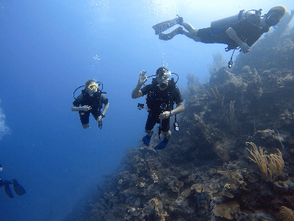
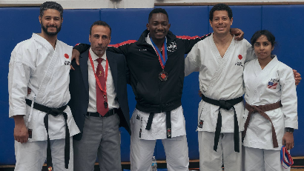
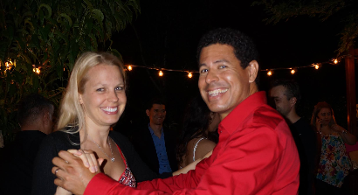
Originally from Colombia. In the USA since 2000. - BS in Mechanical Engineering and concentrated on Robotics and Finite Elements - Master in Information Technology at Harvard University 2010. For a decade I worked as software engineer in different industries: Cyber-security, Computer Graphics for visualization in urban planning, Education and Computer Vision. Currently I teach: - Numerical Analysis, - Wearable Devices, Sensor Data and Machine Learning - Autonomous Robots and AI - Introduction to Bitcoin I supervise: - Theses and capstone for the ALM programs in technology at Harvard.
Jose Luis Ramirez Herran
Head Instructor

Slide 9
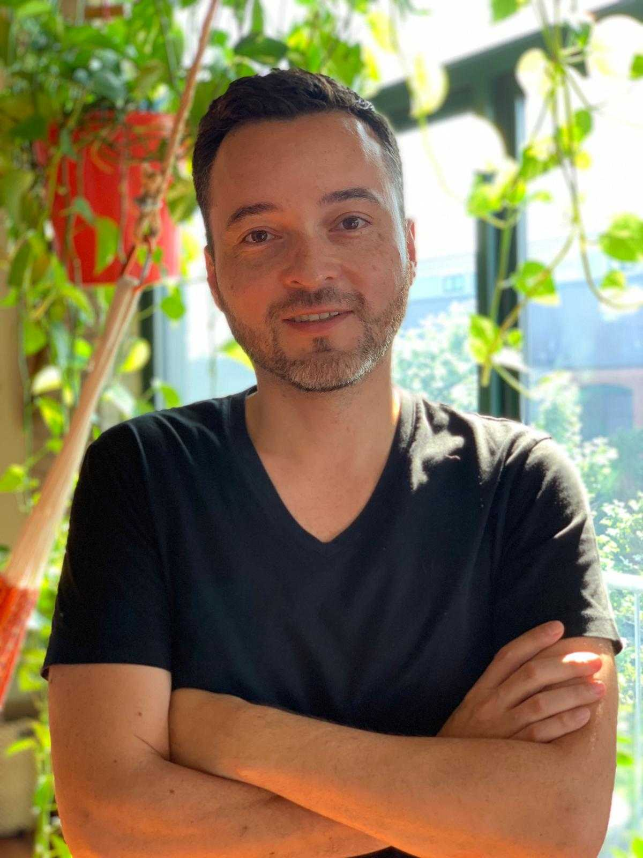
Ricardo Villamil
BS and MS in Computer Science and Software Engineering from Boston University
Worked as Tech Lead at HubSpot (NYSE: HUBS) for five years, responsible for leading the Backend Engineering team that built the CRM.
Currently works at Slang, English learning platform that teaches professional English using ML/NLP.

Slide 10
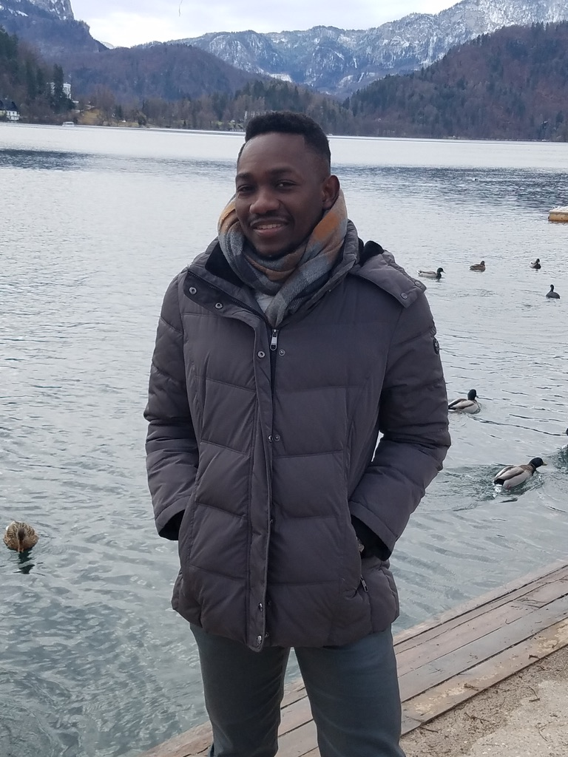
Souleymane Konate, PhD. in Mathematics – Teaching Assistant
I also migrated from Senegal in the early 2000. I attended graduate school in Mathematics in sunny Florida. After my graduation, wondering what “useful mathematics” I could do with my degree, I joined a department of radiology in Boston Area, to work in image reconstruction for thoracic CT and cardiac nuclear medicine. I also taught applied mathematics, including short courses in numerical analysis and linear algebra. Few years ago, out of the blue, I found myself working in public health preparedness and emergency response for natural disasters, in counter-terrorism, and in countering violent extremism at Harvard with the Department of Homeland Security and NATO. As of recently, I co-founded Harmonic Energy Coalescence, a multidisciplinary consulting company. My curiosity has led me to many areas of study and research, and it has also brought me the opportunity to teach with Prof. Ramirez Herran. I am very grateful for another great opportunity to be here.

Slide 11
Students Introductions
Please introduce yourself and tell us something about you:
Talk briefly about your background,
Enrolled in any program here or somewhere else?,
What is your location,
Any hobby?

Slide 12
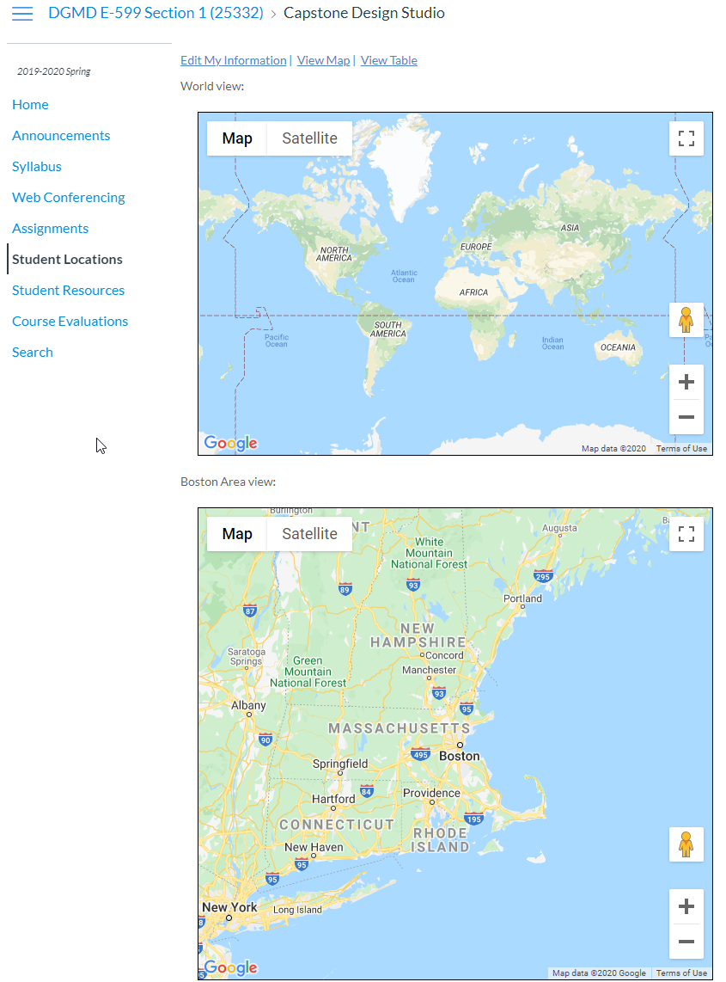
Student Locations
Please take a couple of minutes and submit your location now in Canvas.
Thanks

Slide 13
Piazza
This term we will be using Piazza for class discussion. The system is highly catered to getting you help fast and efficiently from classmates, the TAs, and myself. Rather than emailing questions to the teaching staff, I encourage you to post your questions on Piazza. (https://piazza.com/instructors/Harvard).

Slide 14
Syllabus
Let’s discuss:
Zoom Meetings
Structure of the projects
Objectives
Proof of Concept, Product
Chapters
Presentation
Milestones
Software, equipment, tools
Project Reports
Frequency
Grades and rubrics

Slide 15
Assignments
Wednesdays(small and due before class – 4 pm)
Sundays (Longer and due at midnight)
Both items will be posted every Monday
midnight
4 pm
midnight
4 pm
Project
presentations
Su M Tu W Th F S

Slide 16
The Grading is based on the assignments, quizzes, and on your project.
Description | Undergraduate (%) | Graduate (%)
Assignments (Due every week on Sundays at midnight) | 50 | 40
Quizzes (shorter assignments due before our class on Wednesday at 4 p.m.) | 20 | 20
Participation (posting/answering questions piazza, collaboration with classmates, office hours) Attendance to class is not mandatory since we have an on-demand option. | 20 | 20
Project | 10 | 20

Slide 17
Introduction
Wearable Devices
Computer Vision
Sensor Data
Embedded systems
Machine Learning

Slide 18
Break
7:30 pm – 7:40pm
Break
8:40 pm – 8:50 pm
6:30 pm – 7:30 pm
7:40 pm – 8:40 pm
8:50 pm – 9:30 pm
Part 1
Introduction
Part 2
Hands-on Activity
Discussion
Logistics

Slide 19
We are going to collect data from a wearable
Objective:
To demonstrate how data is collected, and visualized
To demonstrate some steps of the life cycle of a data science project

Slide 20
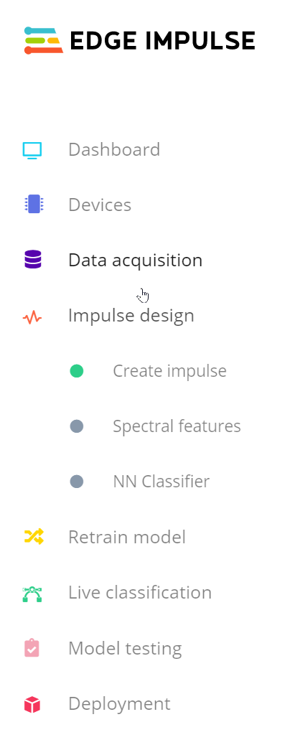
Introducing Edge impulse
A group of developers are in the process to build the next generation of intelligent device solutions with embedded Machine Learning.
With Edge impulse you can send data from a device and use their ingestion service to perform and deploy machine learning models,
as an example:
a continuous motion recognition model or
recognizing sounds from audio.

Slide 21

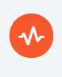
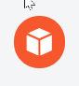
tinyML lifecycle solution transforms developers’ abilities to deploy ML for embedded devices
Collect data: High-quality labeled data is critical for ML analysis. We provide tools and guidance for correct data collection straight from your devices.
Build a model: Combine signal processing, neural networks and anomaly detection to understand the real world.
Deploy and monitor:Deploy models as part of your firmware, monitor model performance in the field, and push updates to devices when you gain more knowledge.

Slide 22
Go to the documentation
https://docs.edgeimpulse.com/docs/getting-started
https://docs.edgeimpulse.com/docs/continuous-motion-recognition
1. Prerequisites
2. Collecting your first data

Slide 23
Machine learning works best with lots of data, so a single sample won't cut it. Now is the time to start building your own dataset. For example, use the following four classes, and record around 3 minutes of data per class:
Idle - just sitting on your desk while you're working.
Snake - moving the device over your desk as a snake.
Wave - waving the device from left to right.
Updown - moving the device up and down.

Slide 24
full group discussion

Slide 25
Break
7:30 pm – 7:35 pm
Break
8:35 pm – 8:40 pm
Part 1
Introduction
Part 2
Hands-on Activity
Part 3
Homework
Questions?
Discussion
Projects
Logistics
6:30 pm – 7:30 pm
7:35 pm – 8:35 pm
8:40 pm – 9:30 pm

Slide 26
Assignment 1

Slide 27
Tutorial 1
Introduction to STMicroelectronics Sensor Tile Development
Environment

Slide 28
Tutorial 1 provides an introduction to the SensorTile platform and its development tools. The steps include:
Installing an Integrated Development Environment (IDE) on a personal computer.
Obtaining reference design example project software. This will specifically include a sensor Data Logging system.
Using the IDE to Import, build, run, debug and flash the SensorTile board to run the example Data Logging project.

Slide 29
Tutorial 2
Sensor System Signal Acquisition,
Event Detection and Configuration

Slide 30
Tutorial 2 provides experience in the development of applications that acquire IoT system sensor signals, detect events in the sensor system data stream, and the configuration of sensor systems. You will be exposed to:
Control of sensor signal acquisition and sensor system configuration.
Sensor signal detection and notifications.
Software system development for the SensorTile IoT system demonstrating important capabilities of the System WorkBench IDE in accelerating system development.

Slide 31
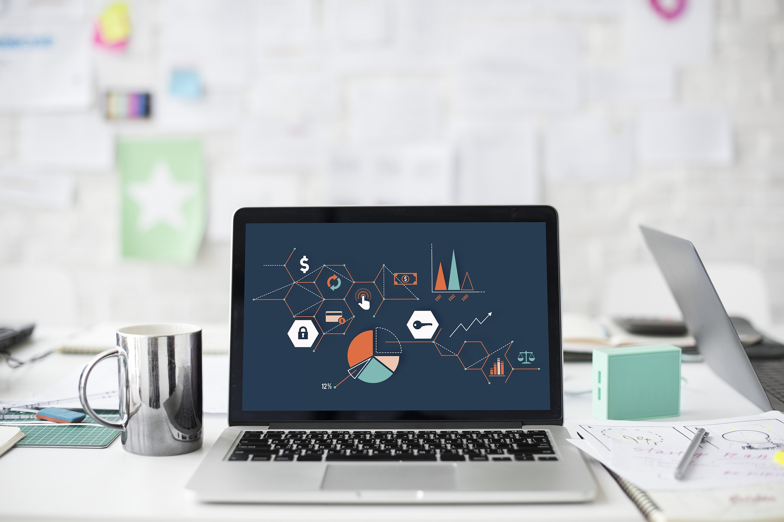
Your project is an part of this course. The project proposal should be clear, concise, and consistent.
Specific Aims
Relevance
Methods
Background and Introduction
Structure of the Project Proposal (1->2 Pages)
Design
Analysis
Ethics, Computer and Society
Continued Learning

Slide 32
Questions?

